Slide 1
Abnormal behavior of users accessing the organization network
Daniel Filler & Ron Peled
Guided by: Itzik Askenazi, Technion;
Alon Barak & Amit Tropper, Cisco

Slide 2

Background
Cisco Identity Service Engine (ISE) is responsible for authenticating and authorizing users that login into an organization network.
For example, in a university, only the students and staff should be able to login.
ISE collects various information about the user.
Time of login, IP, MAC, location, etc.
Stored in syslog files (txt).

Slide 3
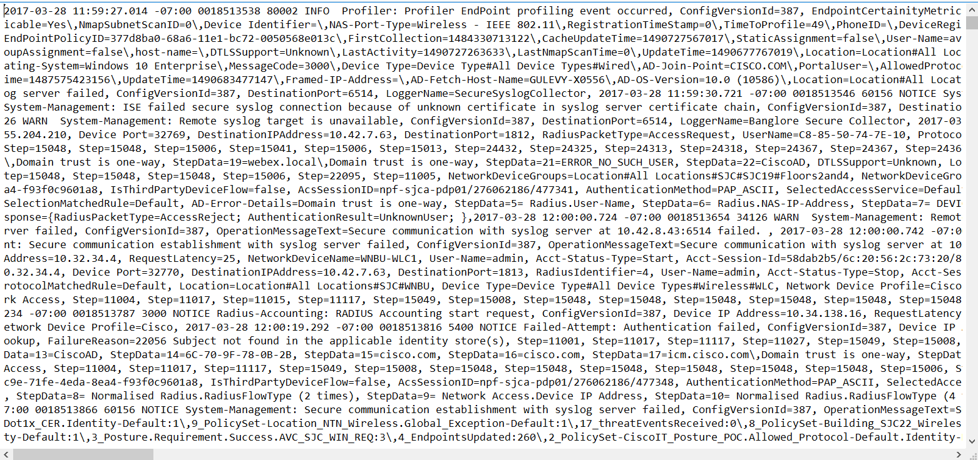
Syslog Example
2017-04-26 01:12:14.797,
Device IP Address=10.56.129.4,
EndPointMACAddress=34-4D-F7-73-99-A1,
...

Slide 4
Objectives
Detect abnormal behavior.
Collect events from ISE in real time.
Normalize the information collected.
Analyze the information for suspicious behavior.
Notify the admin of detected abnormalities.
Generics.
Ability to add new attributes for analysis with relative ease.

Slide 5


Unauthorized access
identified in Haifa
Abnormal
activity
identification
syslog parser
syslog messages
Enterprise Network
New York Branch
Enterprise Network
Haifa Branch
Network Access Devices
(wired / wireless / VPN)
ISE
Network Access Devices
(wired / wireless / VPN)
Unauthorized persona trying to
access the
Enterprise Network
Enterprise
Employees
Enterprise
Employees

Slide 6
Thought Process
Machine learning?
Statistical calculations!
Simpler.
Quicker development.
How to store the data?
CSV files?
Oracle?
MongoDB!
Python.
Definitely.

Slide 7

General Architecture
Initialization
Parser
Running
Parser
Nightly Run
Data update
Pre-calculator
Evaluator
Back to Running stage

Slide 8
General Architecture
Initialization
Parser
Running
Parser
Nightly Run
Data update
Pre-calculator
Evaluator
Back to Running stage
Initialization
Parser – populates the DB with the relevant data collected from the syslogs.
Pre-calculator – performs calculations on the collected data.
Running
Parser – detects new logins from the syslogs.
Evaluator – analyses each new login and decides whether it’s normal or not.
Nightly Run
Populates the DB with the new logins and performs calculations based on it.

Slide 9
What Do We Analyze?
We keep the last 30 days of data.
Login time.
Average login time and standard deviation are calculated.
MAC address.
History of used addresses.
Location.
History of locations logged in from.

Slide 10



How Do We Decide If A Login Is Suspicious?
Each attribute (time, MAC, location…) is given a weight.
A grade is calculated based on the sum of the detected abnormal attributes:
Where is the grade for an attribute and is 1 or 0 as an indication of the suspicion of this attribute.
A threshold is defined.
If the grade is higher than the threshold – then the login is declared suspicious.
Some attributes provoke an alarm disregarding the total calculated grade.
$$w_{i}$$
$$i$$
$$s_{i}$$

Slide 11
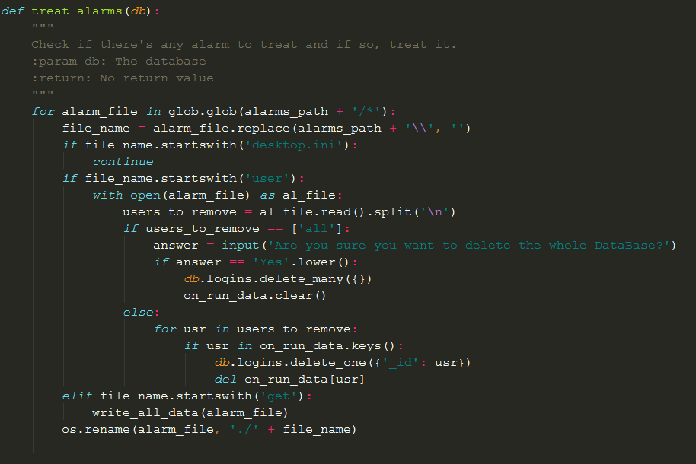
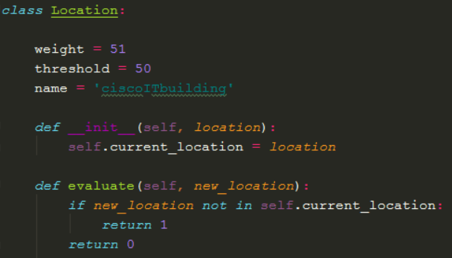
Generics
Was a major emphasis in the development of the project.
Easy to add a new attribute to the analysis process.
Easy to add a new analysis function.
We currently have two of these:
Average and standard deviation calculation.
Unknown members (e.g. a new MAC address is detected).
Easy to change the weights of the attributes.
Easy to change the threshold.
Easy to change the handling of the alarms (output of the system).

Slide 12
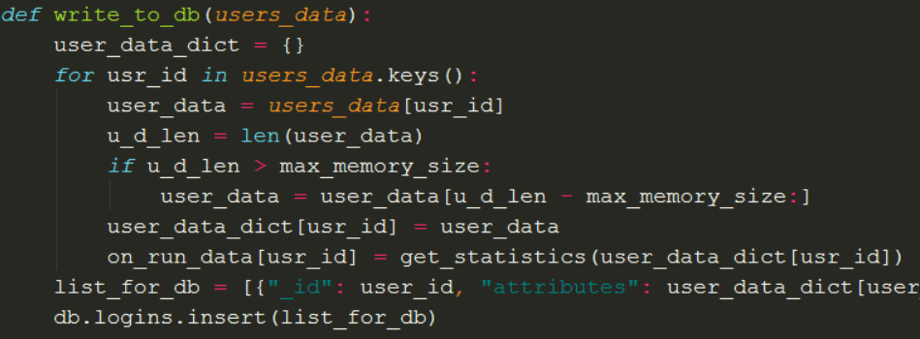
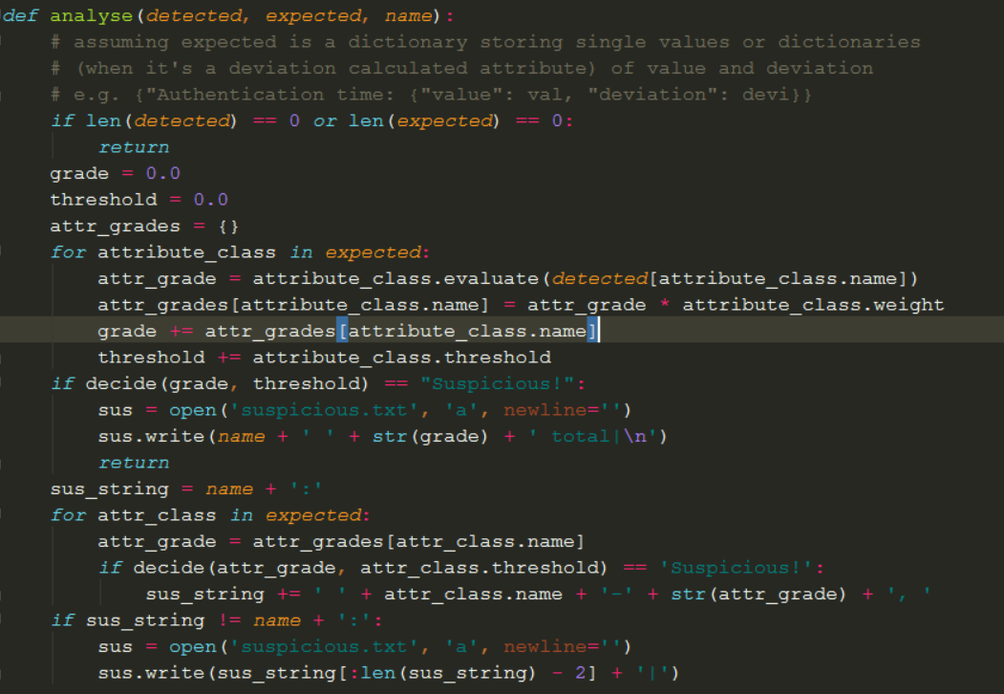

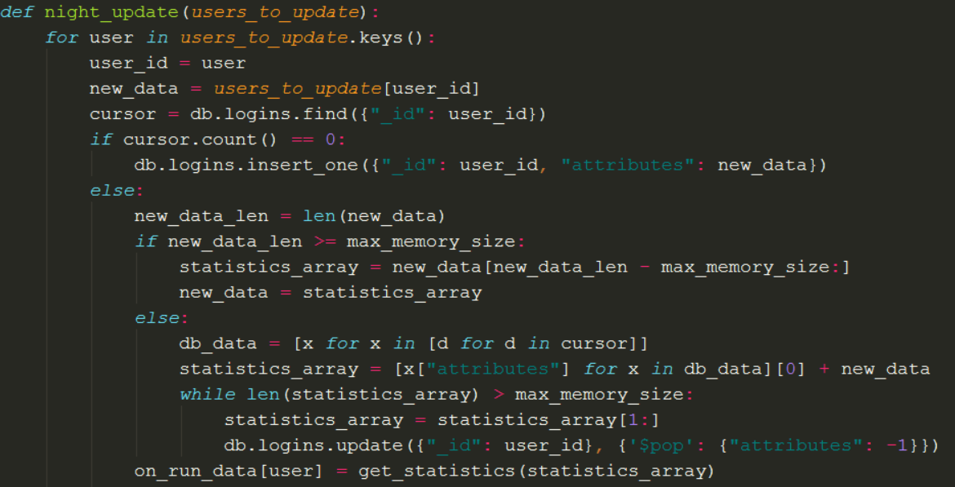



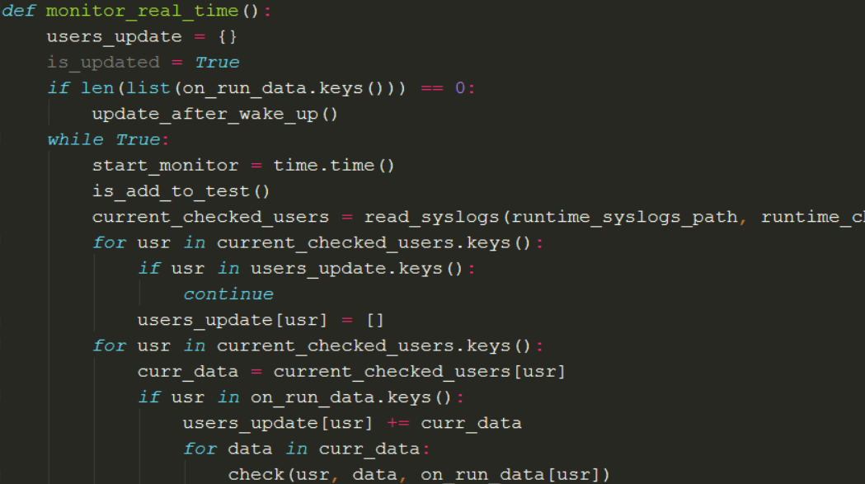

Low-Level Flow
DataBase
Initiate Syslogs
New Syslog File
Monitor File
Over Night Update
10 Sec.
Alarm File
Alarm File
Syslog Files
Output
Analyze and Monitor Syslogs

Slide 13
Live demo

Slide 14
Project Achievements
A generic infrastructure for detecting abnormal behavior.
Three attributes analyzed in real time using statistical calculations.
We introduced ourselves to MongoDB and it’s capabilities.
We became much more proficient in python and generic development.

Slide 15
What Can Be Done Next?
The current analysis can be elaborated.
For example, add the capability to detect multiple known login time per person.
More attributes for analysis can be added.
Device type?
IP-based geographic location?
And many more.
New analysis functions can be added.

Slide 16
Questions?

Slide 17
Thank you! ☺
The end.

